Slide 1
PaceMakers: Predicting Average Heart Rate for Bike Rides
Patrick, Sarah & Esteban
CSC691
December 2, 2019

Slide 2
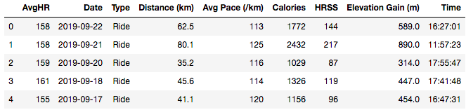
Problem Statement
We have a medium-sized dataset (309 records), comprised mostly of daily cycling activities
Based on other metrics (e.g. Distance, Avg Pace, Elevation Gain, HRSS), can we successfully predict the average heart rate (HR) for future rides?

Slide 3
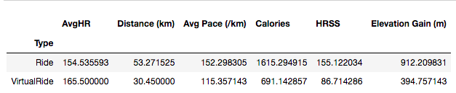
Background
Since HR data is continuous, for binary classifiers, we calculated a threshold and classified all activities as high or low intensity
We want to predict heart rate of future virtual and outdoor rides based on previous historical data
With the ability to predict health metrics, such as heart rate, from workout routines, we can work to improve performance and better understand key indicators for successful workouts.

Slide 4
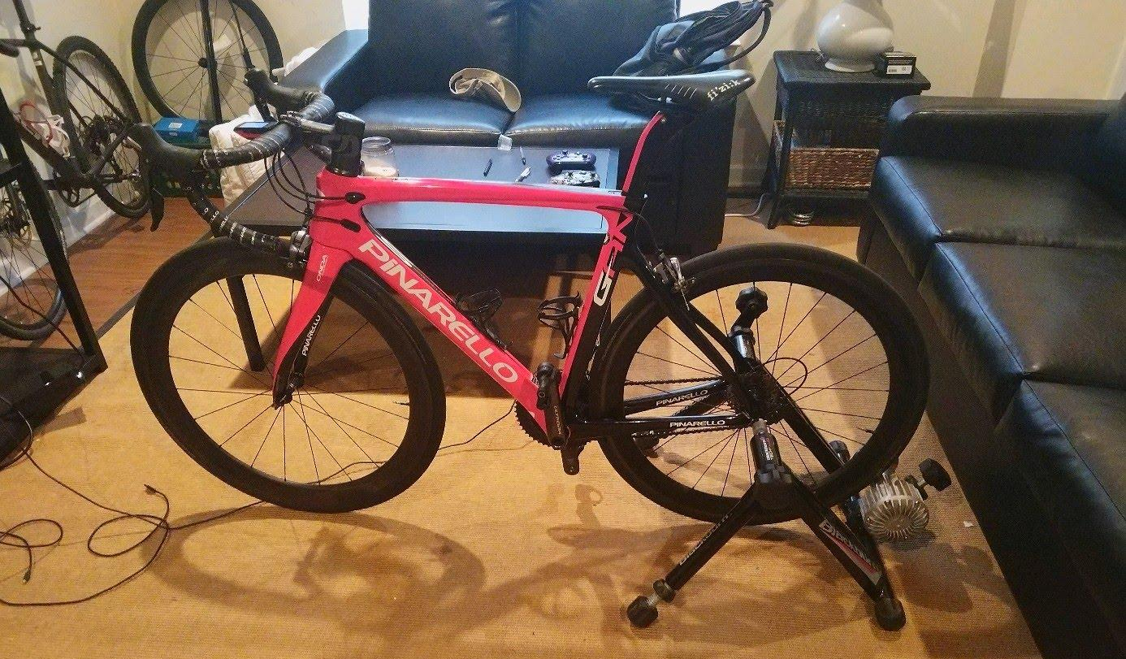
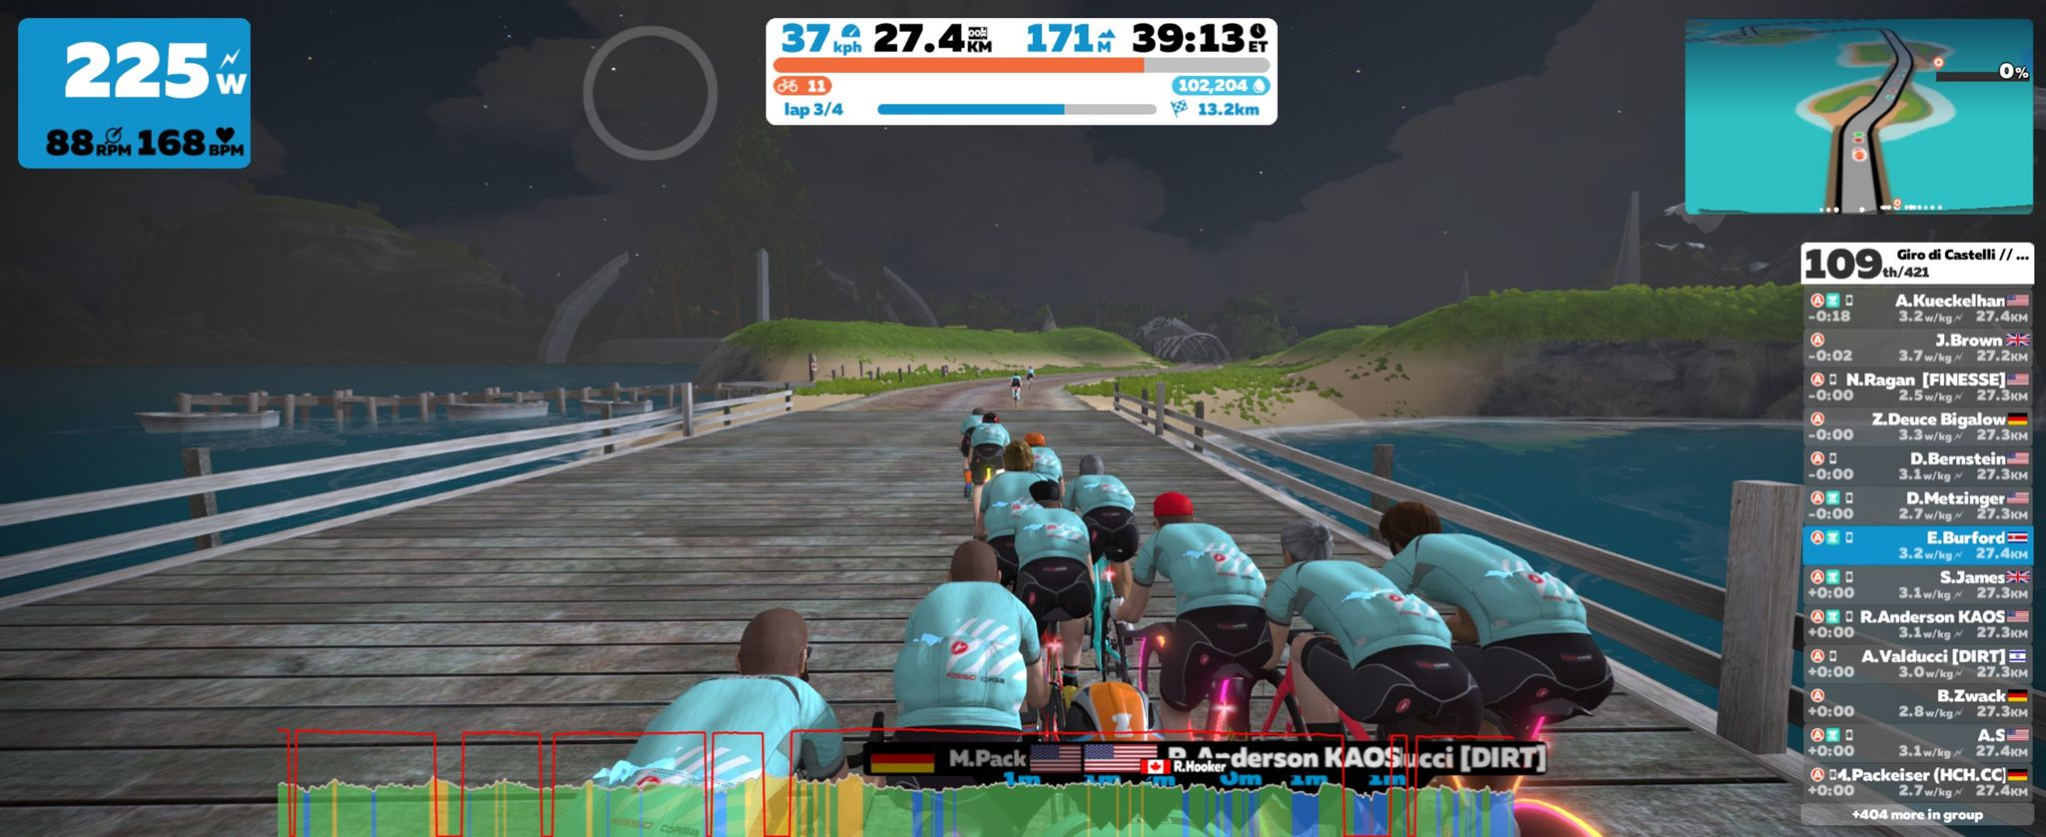
Demo

Slide 5
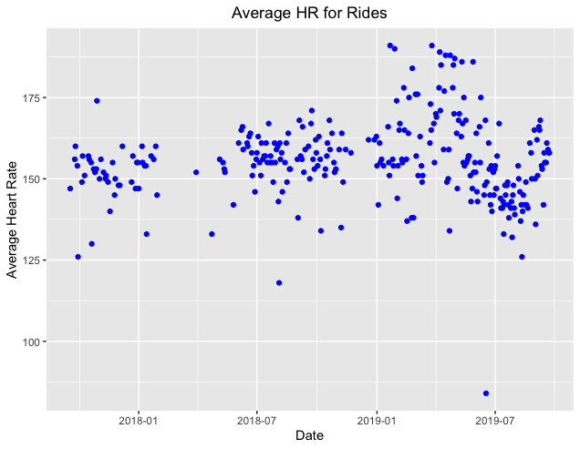
Data
Cycling data history that has been recorded for about 2 years
Data stored in a platform called Strava, extracted with the ‘Elevate’ plugin
CSV file containing all the information regarding the physical activity

Slide 6
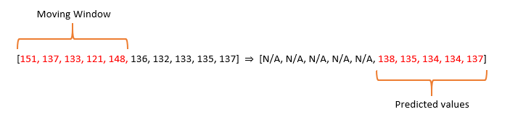
Methods
Moving Average
Binary classification
Regression
Find optimal window size: minimum # of data points necessary to predict one day in future
Find optimal look ahead value: maximum # of days to be predicted

Slide 7
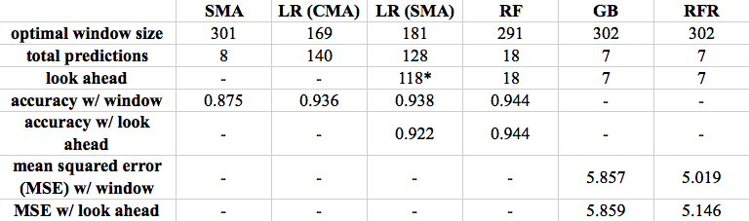
Results
SMA: Simple Moving Average, LR: Logistic Regression, RF: Random Forest, GB: Gradient Boosting Regression, RFR: Random Forest Regression
*128 yielded slightly lower accuracy of 0.914
Notes:
Moving average (simple): predict continuous Average HR using window of 301 to predict 8 future days
Logistic regression: predict binary Average HR (high/low) using window of 181 to predict 128 future days (looking ahead at 118 values)
Random forest: predict binary Average HR (high/low) using window of 291 to predict 18 future days (looking ahead at 18 values)
Random forest regression: predict continuous Average HR using window of 302 to predict 7 future days (looking ahead at 7 days)
Gradient boosting regression: predict continuous Average HR using window of 302 to predict 7 future days (looking ahead at 7 days)

Slide 8
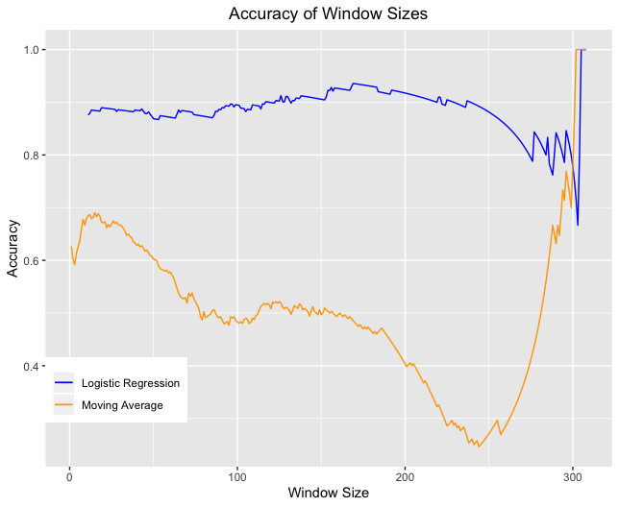
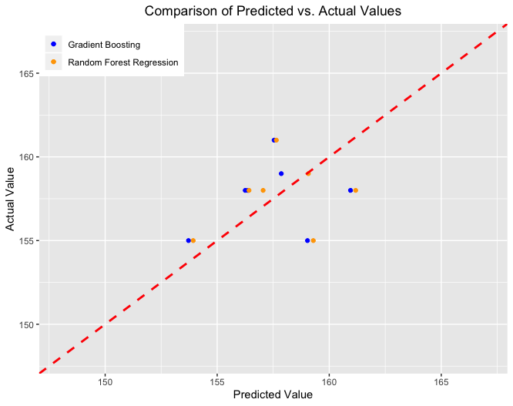
LR (CMA) and Simple Moving Average Accuracies
Predicted vs. Actual Values for Gradient Boosting and Random Forest Regression models

Slide 9
Future Work
Determining HR differences between Regular and Virtual Rides
Using same dataset to classify Regular vs. Virtual Ride
Predict Calories burned based on other exercise metrics
Ethical implications and impact on the sport of cycling

Slide 10
References
Demo video:
https://drive.google.com/open?id=126ogae5jRST8RH8H0X9MQ81-IwQHSb5l

